Slide 1

Twitter Workshop:
Cultivating Your Voice in 280 Characters
Ravynn K. Stringfield
(@RavynnKaMia)
American Studies Ph.D. Candidate
William & Mary

Slide 2
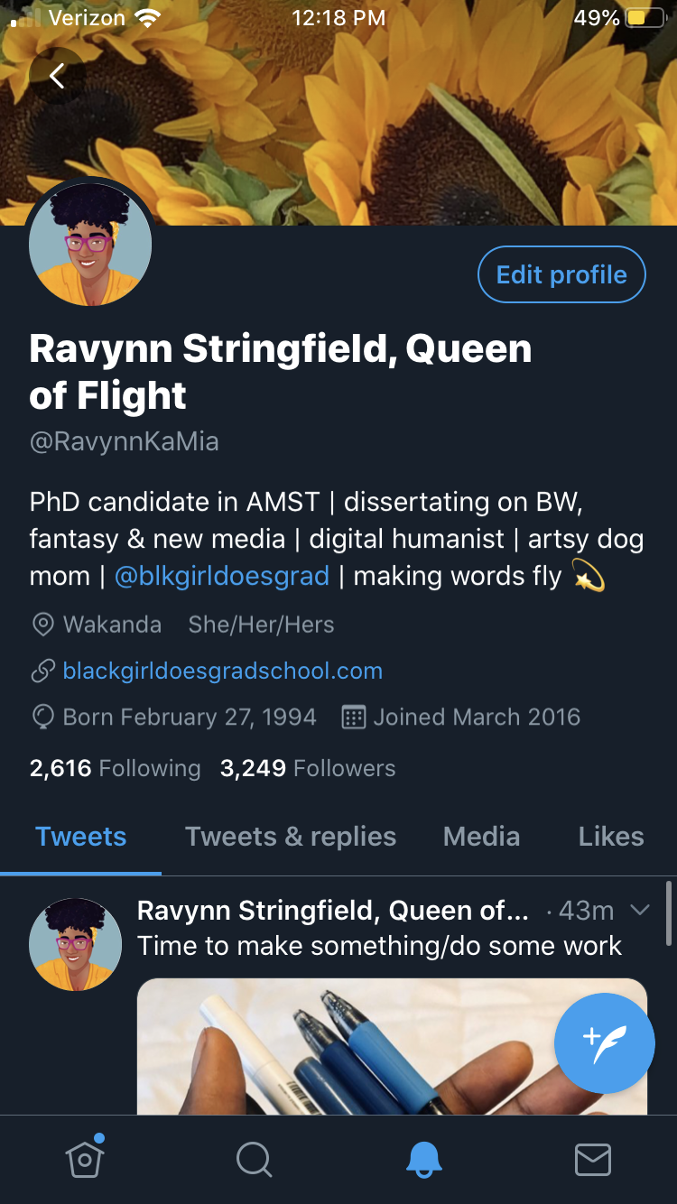

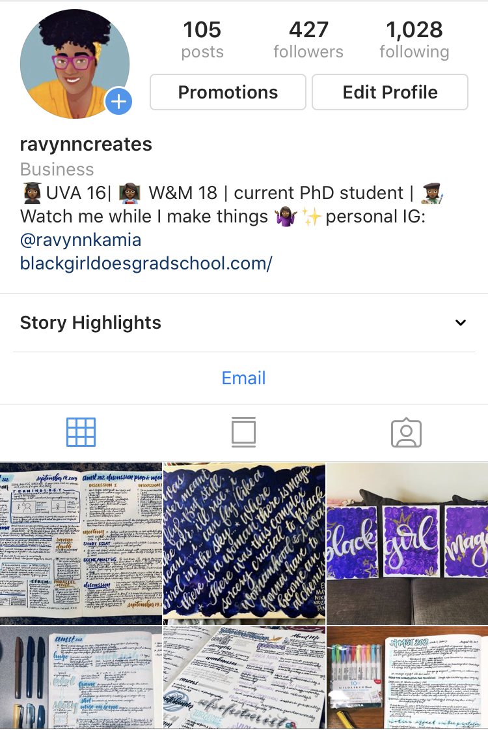
Introductions

Slide 3
Key Points
Social Media Mission Statements
Getting Started on Twitter
Making Your Profile Effective
Following and Building Community
Crafting Content
Interacting with Folks Online
Safety
*Where we are going in this workshop and how we will get there.
@RavynnKaMia

Slide 4
I.
Social Media
Mission Statements

Slide 5
Exercise 1: Developing your Mission
Think about your personal and/or scholarly mission. Do you prioritize teaching? Social justice? Public engagement?
*Develop and jot down 3-5 goals that you think reflect your mission.
Are these things that you would like your social media presence to be able to communicate?
Use these guidelines to help you think about the content you want to curate and create online.

Slide 6
II.
Getting Started

Slide 7
Getting Started on Twitter:
Choosing Your Handle and Display Name
HANDLES (or USERNAMES)
This is your @ name
More permanent; harder, though possible, to change
Shows up in tweets when people tag you
DISPLAY NAMES
Less permanent
Room for creativity and personality

Slide 8
Suggestions for Handles & Display Names
HANDLES
Your Name or Variations
  e.g. @RavynnKaMia or @Ravynn[LastName]
Your Name + Degree (if Applicable)
  E.g. @RavynnPhD or @DrRStringfield
Your Area of Interest
  E.g. @FlyBlackGirls or @BlackMagicRavynn
DISPLAY NAMES
Your Name as you wish to be cited
  E.g. Ravynn K. Stringfield
Seasonal Names (ex. Spooky Halloween names)
  E.g. Poe’s The Ravynn
Personal, but Meaningful, Names
  E.g. Ravynn Stringfield, Queen of Flight

Slide 9
III.
Making an Effective Profile

Slide 10
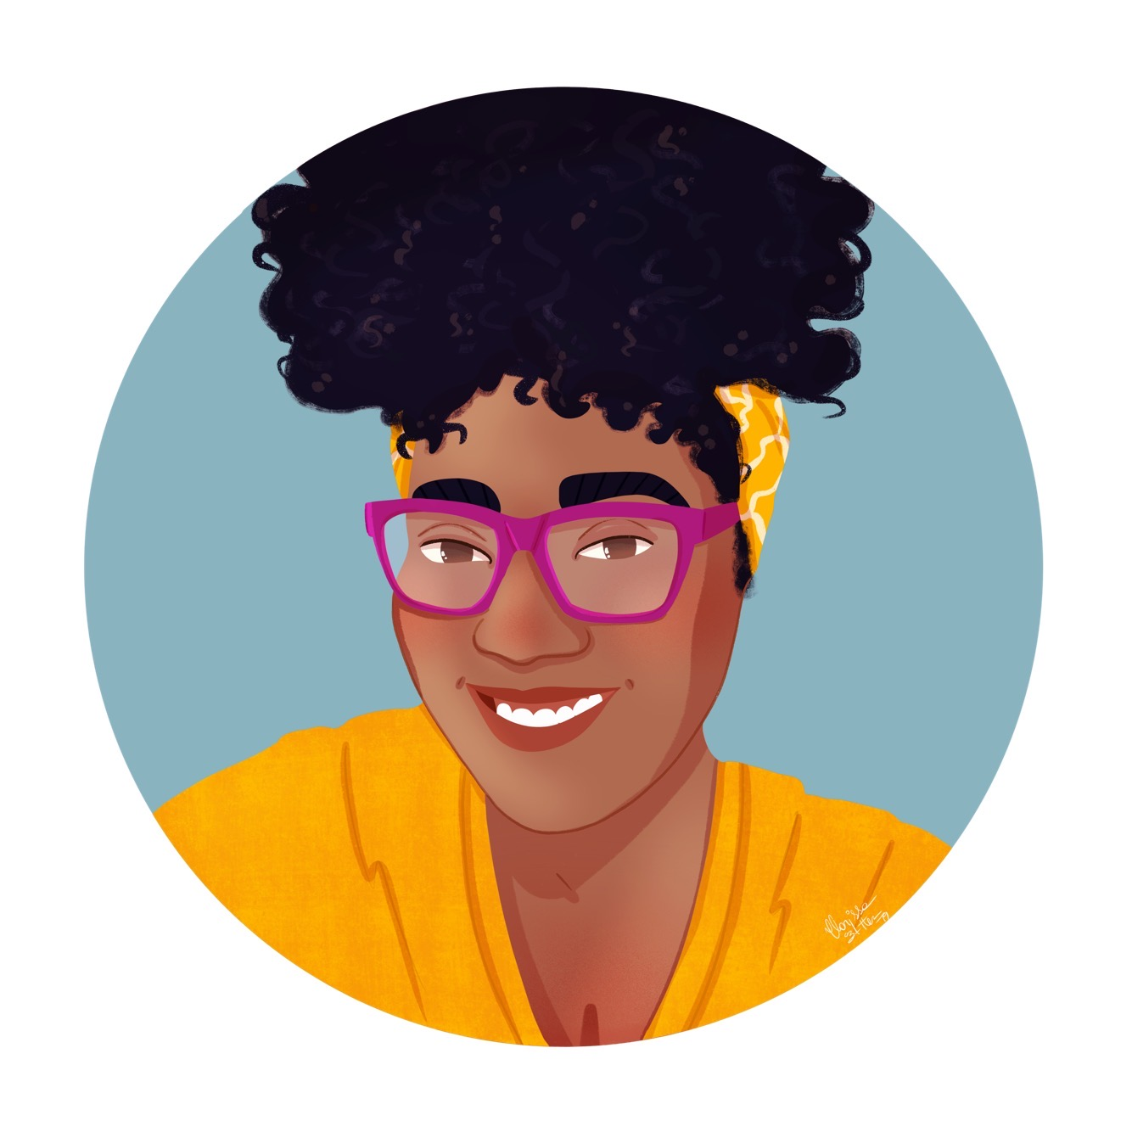
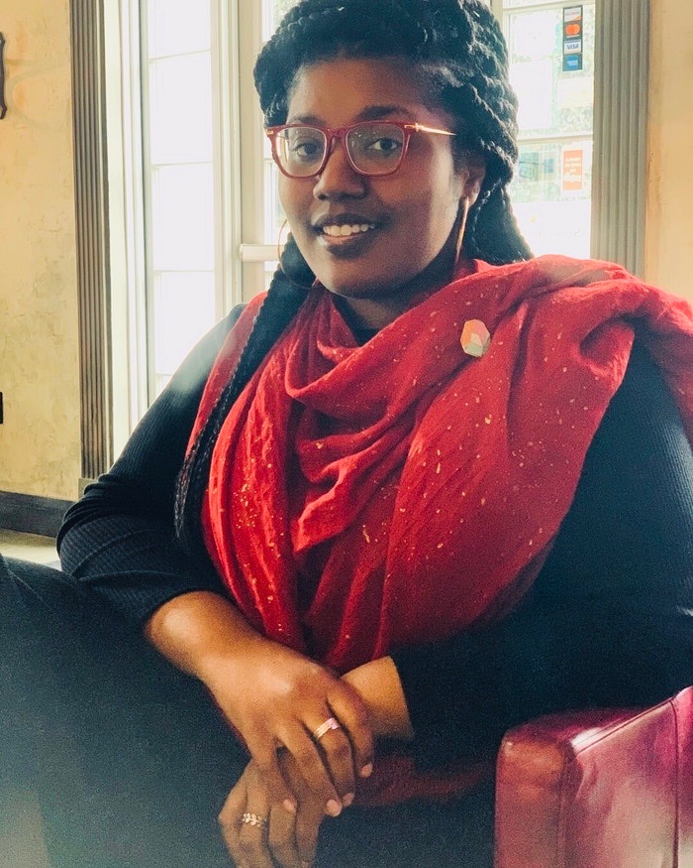

Choosing an Icon
NOTE: If you are planning to use Twitter as a professional account, consider using headshots.
Twitter profile images do show up on Google, so choose carefully
But pick something that shows off your personality! This is a chance to represent yourself.
Or, it doesn’t have to be you at all. It could be a picture of your dog. Up to you.
@RavynnKaMia

Slide 11


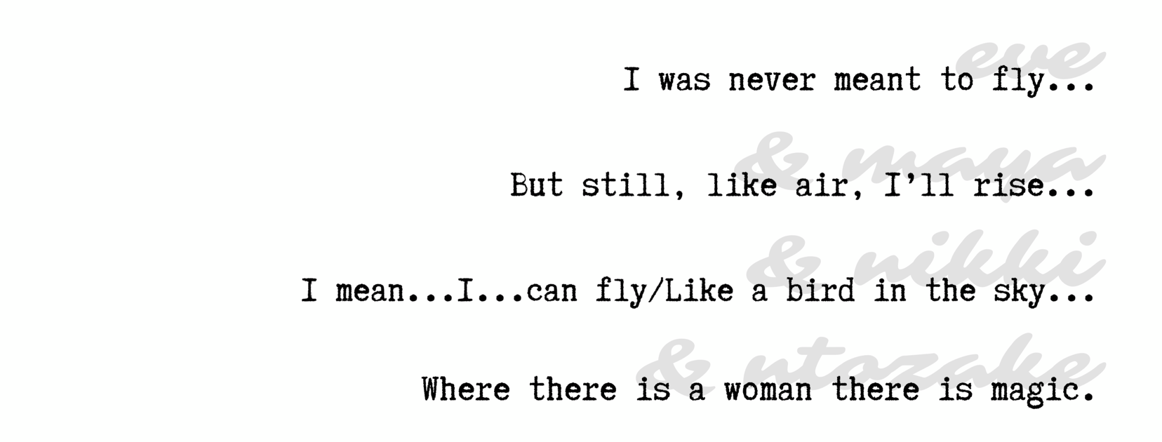
Choosing a Header
An opportunity for a little more personality. Show us what’s important to you, or highlight your research or your latest book project!
@RavynnKaMia

Slide 12
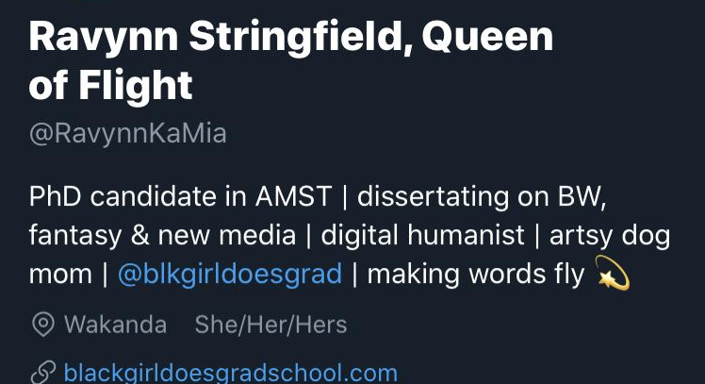
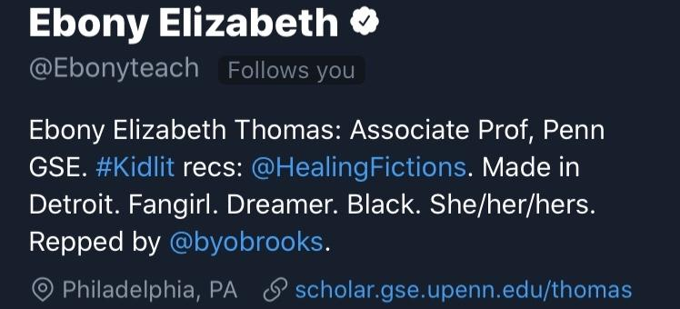
Writing a Bio in 160 Characters
What do you want to communicate to potential followers?
Info to consider adding:
Institutional Affiliation
Position
FIeld
Areas of Interest (try to keep it to three terms)
Pronouns
Fun Stuff!
*If you have a website, link it!
@RavynnKaMia

Slide 13
IV.
Following &
Building Community

Slide 14
Exercise 2: Following!
Take 2 minutes to brainstorm:
Which scholars/writers/artists do you admire?
Which professional organizations do you belong to?
Which institutions do you wish you were more connected to?
Now, google them to see if they have Twitter accounts! It can be as easy as searching the name + Twitter.

Slide 15

HASHTAGS
How to join conversations and communities!
@RavynnKaMia

Slide 16
V.
Crafting Content

Slide 17
Remember that Mission Statement?
Let’s bring it back...

Slide 18
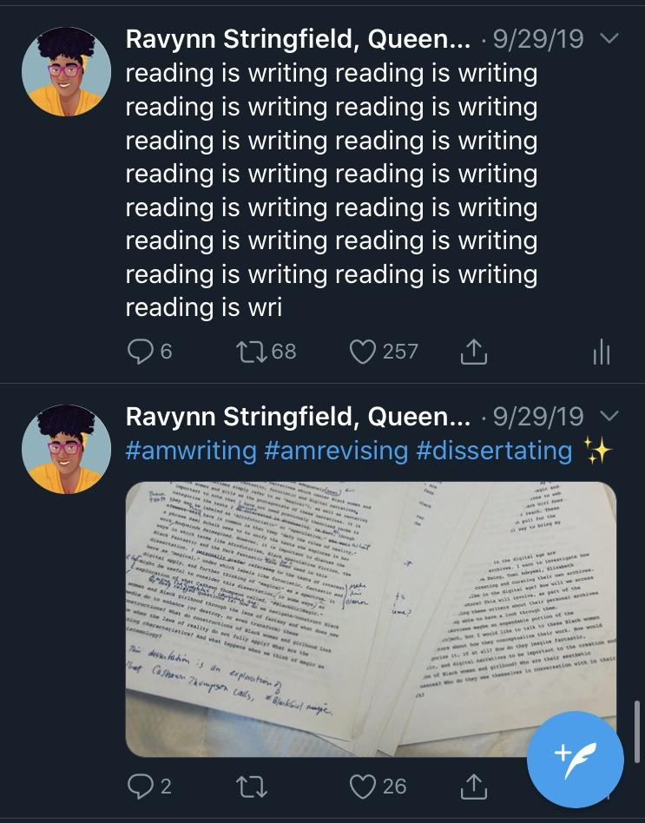
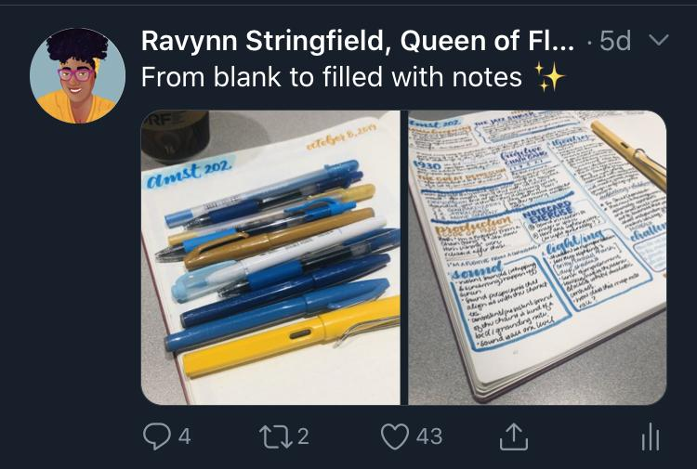
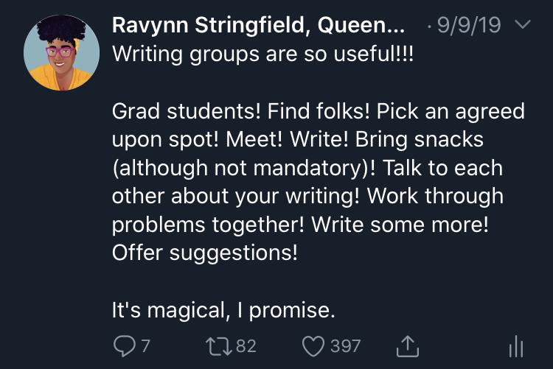
Developing Your Voice in Tweets
Remember your mission and consider:
What’s important to you?
What are you passionate about?
What do you want potential followers to know about you?
What do you want to engage in dialogue about?
This is a chance to use your voice and build a platform for yourself.
Think of Twitter as micro-blogging; this is where thoughts and opinions go.

Slide 19
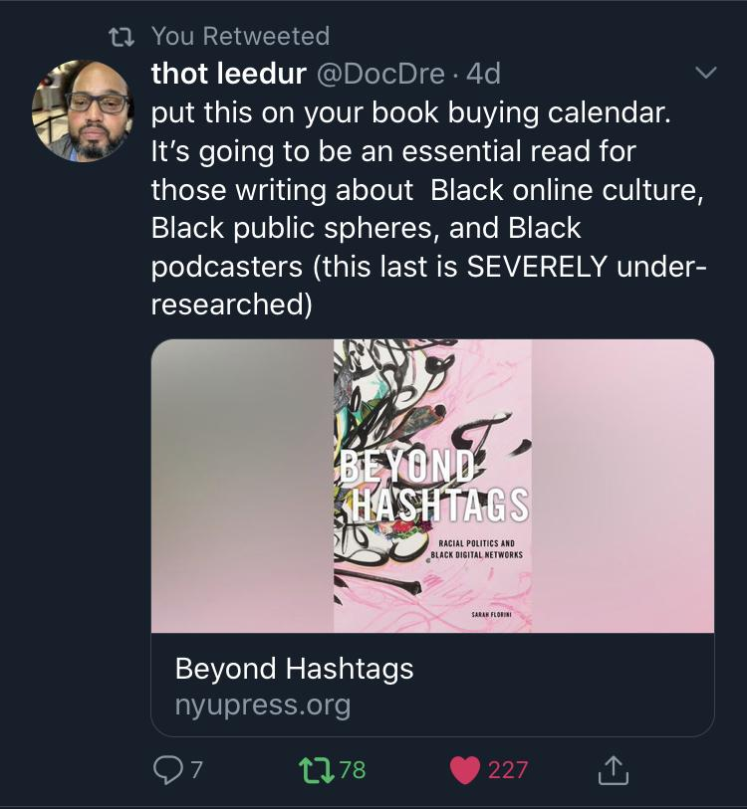
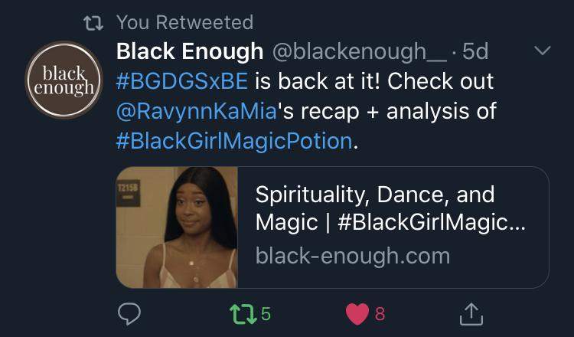
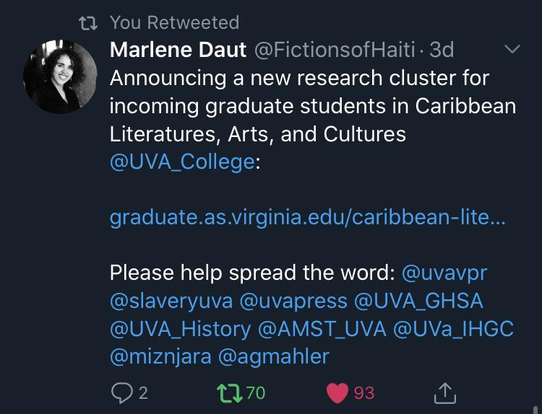
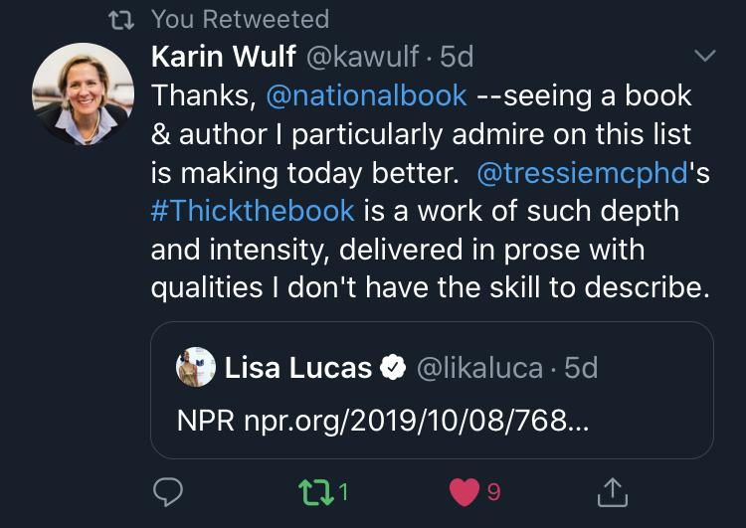
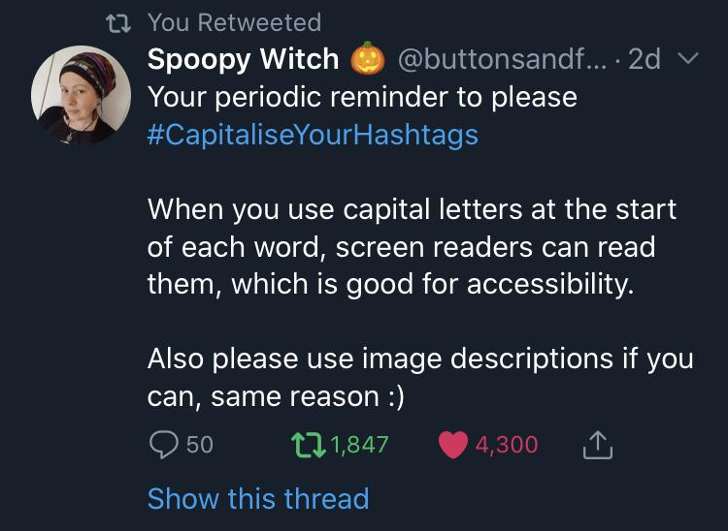
Retweeting
Can be used to support folks and causes
“RT =/= endorsements”
SUGGESTIONS FOR RETWEETING
News you’re passionate about
Articles you find interesting
Relevant Research
Projects
CFPs and Job Listings
Things you find relatable useful or further your mission
USE YOUR BEST JUDGMENT
@RavynnKaMia
retweets

Slide 20
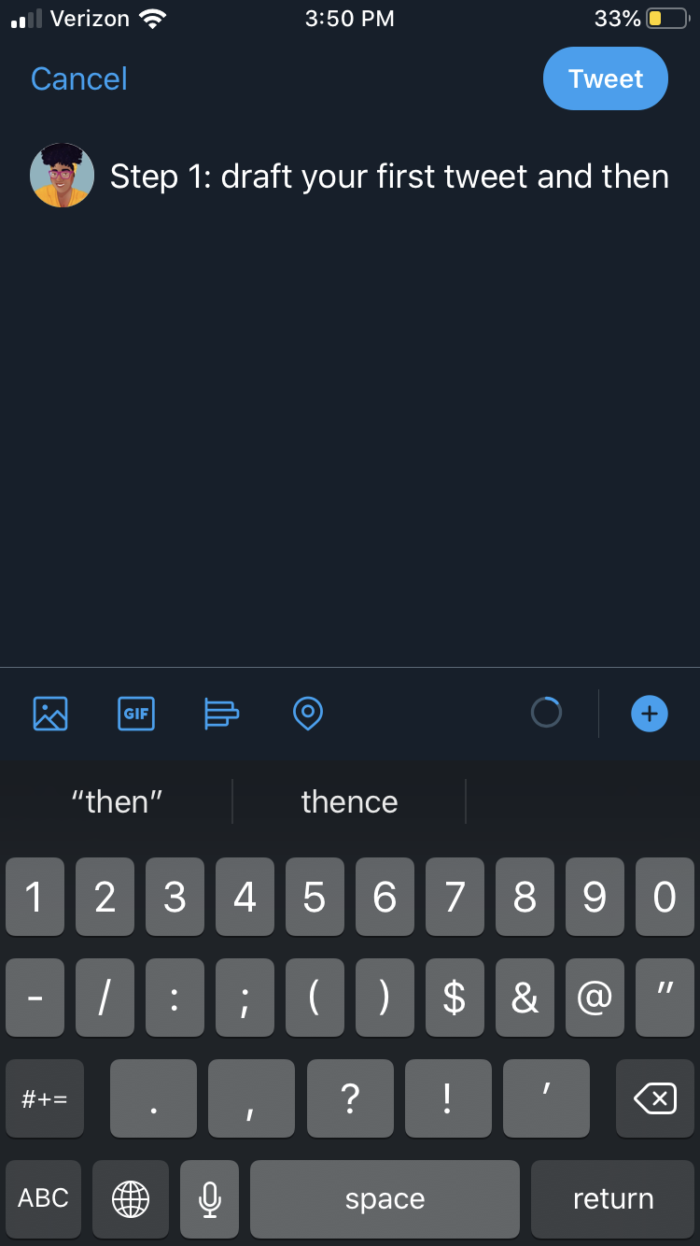
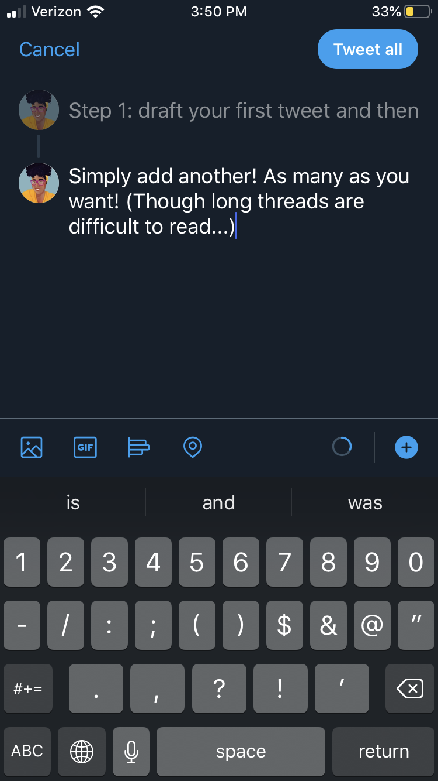
Threads
Sometimes things just don’t fit in one tweets. So create a thread to express slightly longer and more nuanced pieces of writing.
NOTE: If you find yourself regularly writing lengthy threads, I would recommend creating a blog that you can post pieces on and link to on your account!
REMEMBER: Twitter is all about brevity!

Slide 21
VI.
Interacting With Folks Online

Slide 22

Twitter Chats
Different online communities often have conversations around pre-determined topics that take place at a certain time.
Just make sure you’re on Twitter at that date and time. Reply or quote the questions the accounts ask to respond to the questions (Use the hashtag!). Others will likely then respond to your message to start a conversation and you can respond to others!

Slide 23
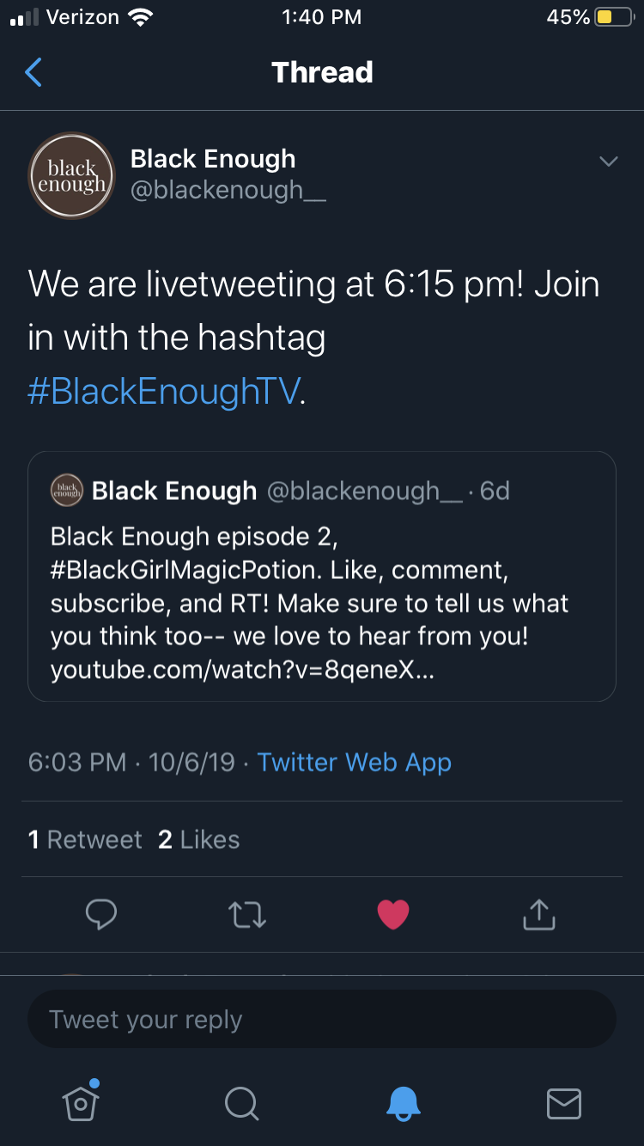
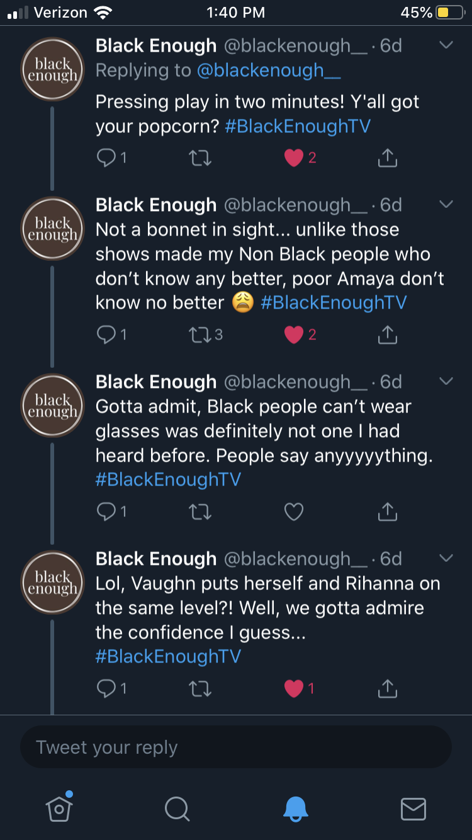
Live Tweeting
Many conferences and events encourage this practice, where you tweet in real time about the presentation in question.
You can ask questions, post quotes, offer thoughts that further the conversation, and engage with others also tweeting about the talk. Make sure to use the event hashtag so others can find your tweets!
NOTE: Do ask presenters if they consent before posting photos of them.

Slide 24
VII.
Safety

Slide 25

HIGHLIGHTS
Set up 2-Factor Authentication on Everything
Use Password Manager and Unique Passwords
Adjust Your Privacy
Delete Old Accounts
Consider Using Pseudonyms
MORE:
https://femtechnet.org/csov/lock-down-your-digital-identity/

Slide 26
Thank you!
Call me, beep me, if you wanna reach me:
Ravynn K. Stringfield
@RavynnKaMia
rkstringfield@email.wm.edu

